Slide 1







Slide 2

 Convex Set.
 Convex Hull.
 Algorithms to computing convex hull.
Quick Hull
Grahams scan
Jarvis march
 Applications.

Slide 3

 X ⊆
R² satisfy the following properties
for any two points p,qϵX.
 The convex linear combination or the entire segment p,q ⊂X,where p and q are two vector points.

Slide 4

 A polygon P is said to be convex if:
- P is non intersecting;and
- For any two points p and q on the boundary of P, segment pq lies entirely inside P.
convex
nonconvex

Slide 5

 Convex hull is defined as a set of given object
 Convex hull of a set Q of points, denoted by CH(Q)is the smallest convex polygon P for which each points in Q is either on the boundary of P or in its interior.

Slide 6

Brute Force Algorithm
Quick Hull
Divide and Conquer
Grahams scan
Jarvis march(Gift wrapping)

Slide 7

 Given a set of points P, test each line segment to see if it makes up an edge of convex hull.

Slide 8
 If the rest of the points are on one side of the segment ,the segment is on the convex hull.
 Otherwise the segment is not on the hull.

Slide 9

Computation time of convex hull using brute force algoritm is O(nᶾ) :-
 O(n) complexity tests, for each of O(n²) edges.
In a d-dimensional space, the complexity is O(nᵈ⁺¹)

Slide 10

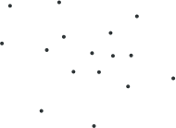
 Quick Hull uses a divide and conquer approach.
 For all a,b,c ϵ P, the points contained in ∆abc∩P cannot be on the convex hull.

Slide 11

 The initial input to the algorithm is an arbitrary set of points.

Slide 12
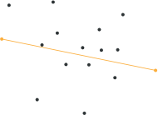
 Starting with the given set of points the first operation done is the calculation of the two maximal points on the horizontal axis.

Slide 13

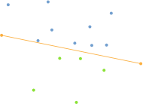
 Next the line formed by these two points is used to divide the set into two different parts.
 Everything left from this line is considered one part, everything right of it is considered another one.
 Both of these parts are processed recursively.

Slide 14
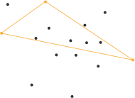
 To determine
the next
point on the convex hull a search for the point with the greatest distance from the dividing line is done.
 This point, together with the line start and end point forms a triangle.

Slide 15

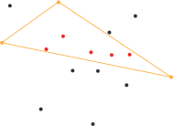
 All points inside this triangle can not be part
of the convex hull
are the
polygon, as they obviously lying in
convex hull of the three selected points.
 Therefore these points can be ignored for every further processing step.

Slide 16

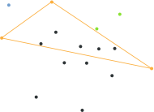
 Having this in mind the recursive processing can take place again.
 Everything right of the triangle is used as one subset, everything left of it as another one.

Slide 17

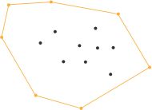
At some recursively point subset
point the processed does only
contain the start and end point of the dividing line.
If this is case this line has to be a segment of the searched hull polygon and the recursion can come to an end.

Slide 18

QuickHull(s)
{
//Find convex hull from the set S of n points. Convex hull:={}
Find left and right most points,say A and B, and add A and B to convex hull
Segment AB divides the remaining (n-2)points into 2 groups S1
and S2.
where S1 are points in S that are on the right side of the oriented
line from A to B
and S2 are points in S that are on the right side of the oriented
line from B to A
FindHull (S1,A,B)
FindHull (S2,B,A)

Slide 19
Findhull (Sk,P,Q)
{
//find points on convex hull from the set of points that are on the right side of the oriented line from P to Q
If Sk has no points, then return.
From the given set of points in Sk, find farthest point,say c, from segment PQ
Add points C to convex hull at the location between P and Q three
points P,Q and C partition the remaining points of Sk into 3 subsets
: S0,S1,S2
Where S0 are points inside triangle PCQ, S1 are points on the right side of the oriented line from P to C and S2 are points on the right side of the oriented line from from C to Q.
FindHull (S1,P,C)
FindHull (S2,C,Q)

Slide 20

T(n)=2T(n/2)+O(n)
T(n)= Θ(nlogn) ; Average case T(n)=O(n²); Worst case

Slide 21

 Graham scan is a method of computing the convex hull of a finite set of points in the plane with time complexity O(n logn).
 The algorithm finds all vertices of the convex hull ordered along its boundary
 Graham's scan solves the convex-hull problem by maintaining a stack S of candidate points. Each point of the input set Q is pushed once onto the stack.

Slide 22
 And the points that are not vertices of CH(Q) are eventually popped from the stack. When the algorithm terminates, stack S contains exactly the vertices of CH(Q), in counterclockwise order of their appearance on the boundary.
 When we traverse the convex hull counter clockwise, we should make a left turn at each vertex.
 Each time the while loop finds a vertex at which we make a non left turn ,the vertex is popped from the vertex.

Slide 23
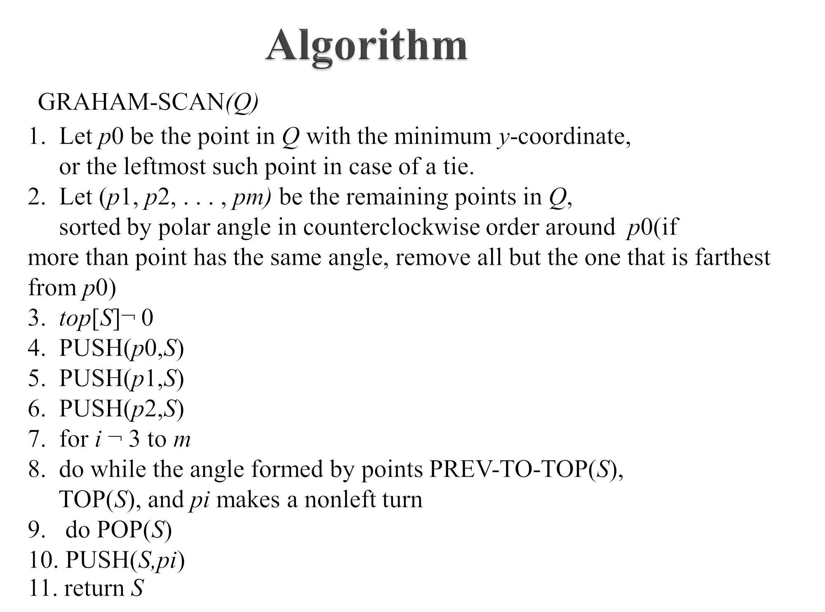

Slide 24

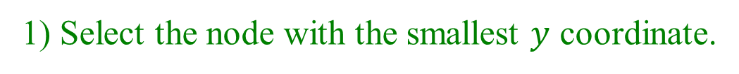
Graham Scan
1) Select the node with the smallest $y$ coordinate.
$$p_{0}$$
This node will be a vertex of the convex hull.

Slide 25

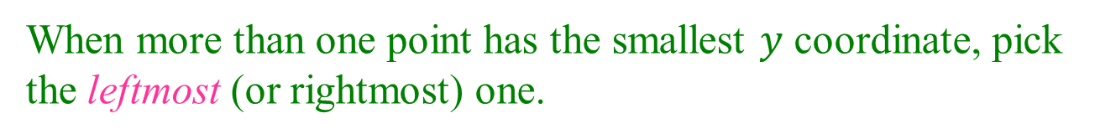
Tie Breaking (1)
When more than one point has the smallest $y$ coordinate, pick
the leftmost (or rightmost) one.
$$p_{0}$$

Slide 26




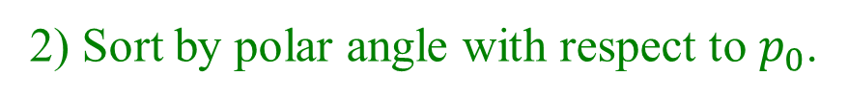







Sorting by Polar Angle
2) Sort by polar angle with respect to $p_{0}$.
$$p_{9}$$
$$p_{6}$$
$$p_{4}$$
$$p_{11}$$
$$p_{7}$$
$$p_{3}$$
$$p_{8}$$
$$p_{10}$$
$$p_{5}$$
$$p_{2}$$
$$p_{1}$$
$$p_{0}$$
$$p_{0}$$
Labels are in the polar angle order.

Slide 27





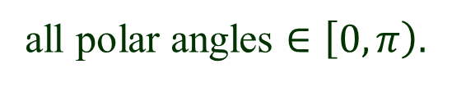

No Polar Angle Evaluation
$p_{0}$ is the lowest (and leftmost)
all polar angles $∈\left[0, π\right).$
$Use cross product!$
$$p_{i}< p_{j}$$
if
$$\vec{p_{0}p_{i}} ×\vec{p_{0}p_{j}}>0$$
$$p_{i}$$
$$p_{j}$$
$$p_{0}$$

Slide 28









Tie Breaking (2)
What if ${p_{0}, p}_{i}, p_{j} are on the same line?$
Order them by distance from $p_{0}$.
$$p_{i}< p_{j}$$
if and
$$\vec{p_{0}p_{i}} ×\vec{p_{0}p_{j}}=0$$
$$\left|\vec{p_{0}p_{i}}\right|<|\vec{p_{0}p_{j}}|$$
$$p_{j}$$
No square roots.
Use dot product!
$$p_{i}$$
$$p_{0}$$
$$\vec{p_{0}p_{i}}∙\vec{p_{0}p_{i}}<\vec{p_{0}p_{j}}∙\vec{p_{0}p_{j}}$$

Slide 29

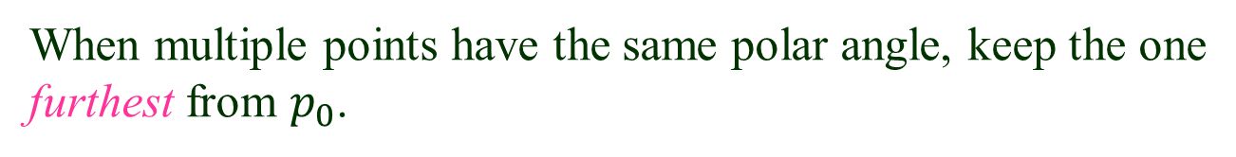


Point Elimination
When multiple points have the same polar angle, keep the one
furthest from $p_{0}$.
Remove the rest since they cannot possibly be the hull vertices.
furtherest
$$p_{j}$$
$$p_{i}$$
remove
$$p_{0}$$

Slide 30
Stack Initialization
3) S$can points in the increasing order of polar angle,$
maintaining a stack.
$$p_{9}$$
$$p_{6}$$
$$p_{4}$$
$$p_{11}$$
$$p_{7}$$
$$S$$
$$p_{3}$$
$$p_{2}$$
$$p_{8}$$
$$p_{10}$$
$$p_{5}$$
$$p_{1}$$
$$p_{2}$$
$$p_{1}$$
$$p_{0}$$
$$p_{0}$$

Slide 31
$$p_{9}$$
$$p_{6}$$
$$p_{4}$$
$$p_{11}$$
$$p_{7}$$
$$S$$
$$p_{3}$$
$$p_{3}$$
$$p_{8}$$
$$p_{10}$$
$$p_{5}$$
$$p_{1}$$
$$p_{2}$$
$$p_{1}$$
$$p_{0}$$
$$p_{0}$$

Slide 32
$$p_{9}$$
$$p_{6}$$
$$p_{4}$$
$$p_{11}$$
$$p_{7}$$
$$S$$
$$p_{3}$$
$$p_{4}$$
$$p_{8}$$
$$p_{10}$$
$$p_{5}$$
$$p_{1}$$
$$p_{2}$$
$$p_{1}$$
$$p_{0}$$
$$p_{0}$$

Slide 33
$$p_{9}$$
$$p_{6}$$
$$S$$
$$p_{4}$$
$$p_{11}$$
$$p_{7}$$
$$p_{5}$$
$$p_{3}$$
$$p_{4}$$
$$p_{8}$$
$$p_{10}$$
$$p_{5}$$
$$p_{1}$$
$$p_{2}$$
$$p_{1}$$
$$p_{0}$$
$$p_{0}$$

Slide 34
$$p_{9}$$
$$p_{6}$$
$$S$$
$$p_{4}$$
$$p_{11}$$
$$p_{7}$$
$$p_{6}$$
$$p_{3}$$
$$p_{4}$$
$$p_{8}$$
$$p_{10}$$
$$p_{5}$$
$$p_{1}$$
$$p_{2}$$
$$p_{1}$$
$$p_{0}$$
$$p_{0}$$

Slide 35
$$S$$
$$p_{6}$$
$$p_{8}$$
$$p_{9}$$
$$p_{4}$$
$$p_{7}$$
$$p_{11}$$
$$p_{7}$$
$$p_{6}$$
$$p_{3}$$
$$p_{4}$$
$$p_{8}$$
$$p_{10}$$
$$p_{5}$$
$$p_{1}$$
$$p_{2}$$
$$p_{1}$$
$$p_{0}$$
$$p_{0}$$

Slide 36

$$S$$
$$p_{9}$$
$$p_{6}$$
$$p_{4}$$
$$p_{7}$$
$$p_{11}$$
$$p_{7}$$
$$p_{6}$$
$$p_{3}$$
$$p_{4}$$
$$p_{8}$$
$$p_{10}$$
$$p_{5}$$
$$p_{1}$$
$$p_{2}$$
$$p_{1}$$
$$p_{0}$$
$$p_{0}$$

Slide 37
$$S$$
$$p_{6}$$
$$p_{10}$$
$$p_{9}$$
$$p_{4}$$
$$p_{9}$$
$$p_{11}$$
$$p_{7}$$
$$p_{6}$$
$$p_{3}$$
$$p_{4}$$
$$p_{8}$$
$$p_{10}$$
$$p_{5}$$
$$p_{1}$$
$$p_{2}$$
$$p_{1}$$
$$p_{0}$$
$$p_{0}$$

Slide 38
$$S$$
$$p_{6}$$
$$p_{11}$$
$$p_{9}$$
$$p_{4}$$
$$p_{9}$$
$$p_{11}$$
$$p_{7}$$
$$p_{6}$$
$$p_{3}$$
$$p_{4}$$
$$p_{8}$$
$$p_{10}$$
$$p_{5}$$
$$p_{1}$$
$$p_{2}$$
$$p_{1}$$
$$p_{0}$$
$$p_{0}$$

Slide 39
Finish
S
$$p_{6}$$
$$p_{11}$$
$$p_{9}$$
$$p_{4}$$
$$p_{9}$$
$$p_{11}$$
$$p_{7}$$
$$p_{6}$$
$$p_{3}$$
$$p_{4}$$
$$p_{8}$$
$$p_{10}$$
$$p_{5}$$
$$p_{1}$$
$$p_{2}$$
$$p_{1}$$
$$p_{0}$$
$$p_{0}$$

Slide 40
 Phase 1 takes time O(N logN) points are sorted by angle around the anchor
 Phase 2 takes time O(N) each point is inserted into the sequence exactly once, and each point is removed from the sequence at most once
 Total time complexity O(N log N)

Slide 41

 Proposed by R.A. Jarvis in 1973
 1.Also known as the “gift wrapping” technique.
 2.Start at some extreme point on the hull.
 3.In a counterclockwise fashion, each point within the hull is visited and the point that undergoes the largest right-hand turn from the current extreme point is the next point on the hull.
 4.Finds the points on the hull in the order in which they appear.

Slide 42
 This is perhaps the most simple-minded algorithm for
the convex hull , and yet in some cases it can be very fast. The basic idea is as follows:
 Start at some extreme point, which is guaranteed to be on the hull.
 At each step, test each of the points, and find the one which makes the largest right-hand turn. That point has to be the next one on the hull.
 Because this process marches around the hull in counter- clockwise order, like a ribbon wrapping itself around the points, this algorithm also called the "gift-wrapping" algorithm

Slide 43


Slide 44
 The corresponding convex hull algorithm is called Jarvis’s march. Which builds the hull in
O(nh) time by a process called “gift-wrapping”.
 The algorithm operates by considering any one point that is on the hull say, the lowest point.
 We then ﬁnd the “next” edge on the hull in counter clockwise order.

Slide 45
 In order to find the biggest right hand turn, the last two points added to the hull, p1 and p2, must be known.
 Assuming p1 and p2 are known, the angle these two points form with the remaining possible hull points is calculated. The point that minimizes the angle is the next point in the hull.
 Continue to make right turns until the original point is reached and the hull is complete.

Slide 47
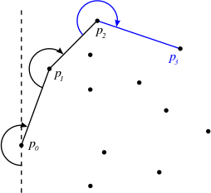

Slide 48
 The idea of Jarvis’s Algorithm is simple, we start from the leftmost point (or point with minimum x coordinate value) and we keep wrapping points in counter clockwise direction.
 The big question is, given a point p as current point, how to
find the next point in output?
 The idea is to use orientation()here. Next point is selected as the point that beats all other points at counter clockwise orientation, and the point which has right hand most turn is taken as next point.

Slide 49
Algorithm
First, a base point p_{o} is selected, this is the point with the minimum y-coordinate
Select leftmost point in case of tie.
The next convex hull vertices p₁ has the least polar angle w.r.t. the positive horizontal ray from p_{o}.
Measure in counter clockwise direction.
If tie, choose the farthest such point.
Vertices p₂, p₃, . . . , p_{k} are picked similarly until yk = ymax
^{p}i+1
has least polar angle w.r.t. positive ray
from p_{o}.
If tie, choose the farthest such point.

Slide 50
Implementation technique
 The points are stored in a fixed array of size one thousand.
 A static sized contiguous array is an appropriate data structure because of the algorithm’s sequential and repetitious point checking.
 Searching operations would be considerably slower assuming non-contiguous memory allocation of nodes in a linked list.
 Using a static array makes it far more likely the data with be brought into cache, where operations can happen considerably faster.

Slide 51
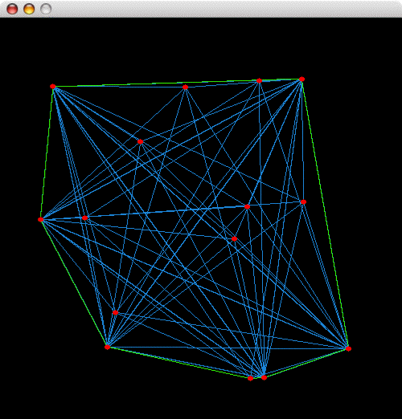

Slide 52
Application
 Blue lines represent point-to-point comparisons. As Jarvis’ March progresses around the convex hull,it finds the point with the most minimal or maximal angle relative to itself; that is the next point in the convex hull.
 Blue lines radiate from every point in the completed polygon. This is because the algorithm tests every point in the set at every node in the convex hull.
 Although not visible, blue lines also show tests between neighbor points. However, because those edges are part of the perimeter of the convex hull, a green line covers them.

Slide 53

 O(nh) complexity, with n being the total number of points in the set, and h being the number of points that lie in the convex hull.
 This implies that the time complexity for this algorithm is the number of points in the set multiplied by the number of points in the hull
 The worst case for this algorithm is denoted by
O(n2), which is not optimal.
 Favorable conditions in which to use the Jarvis march include problems with a very low number of total points, or a low number of points on the convex hull in relation to the total number of points.

Slide 54
 Since the algorithm spends O(n) time for each convex hull vertex, the worst-case running time is O(n²).
 However, if the convex hull has very few vertices, Jarvis's march is extremely fast.
 A better way to write the running time is O(nh), where h is the number of convex hull vertices.
 In the worst case, h = n, and we get our old O(n²) time bound, but in the best case h = 3, and the algorithm only needs O(n) time.
 This is a so called output-sensitive algorithm, the smaller the output, the faster the algorithm.

Slide 55
Computer visualization, ray tracing
(e.g. video games, replacement of bounding boxes)
Path finding
(e.g. embedded AI of Mars mission rovers)
Geographical Information Systems (GIS) (e.g. computing accessibility maps)
Visual pattern matching
(e.g. detecting car license plates)
Verification methods
(e.g. bounding of Number Decision Diagrams)
Geometry
(e.g. diameter computation)

Slide 56

Que1. Computation time of convex hull using brute force algorithm is O(nᶾ):-O(n) complexity tests, for each of O(n²) edges. Give an O(nlogn) time complexity for computing the convex hull.
Ques2. Consider 10 points (P₀ to P₉) and then construct a convex hull using Graham scan method.

Slide 57


